Slide 1

Customer Shopping Behavior Analysis

Slide 2

Project Overview
Analyzing 3,900 customer transactions to uncover insights into spending patterns, segments, and preferences.
Goal: Guide data-driven business decisions.

Slide 3

Dataset Summary
Our dataset provides a comprehensive look into customer behavior, allowing for in-depth analysis of spending patterns and preferences.
3,900
18
37
Rows
Columns
Null Values
Customer Transactions
Key Data Points
Handled in "Review Rating"
Key Features
Demographics
Purchase Details
Discounts & Subscriptions
Review Ratings
Shipping Types

Slide 4
Data Cleaning & Preparation (Python)
01
02
03
Data Loading
Missing Values
Column Standardization
Imported dataset using pandas.
Imputed "Review Rating" using median.
Renamed to snake_case.
04
05
Feature Engineering
Database Integration
Created age_group, purchase_frequency_days.
Connected Python to PostgreSQL for SQL analysis.

Slide 5
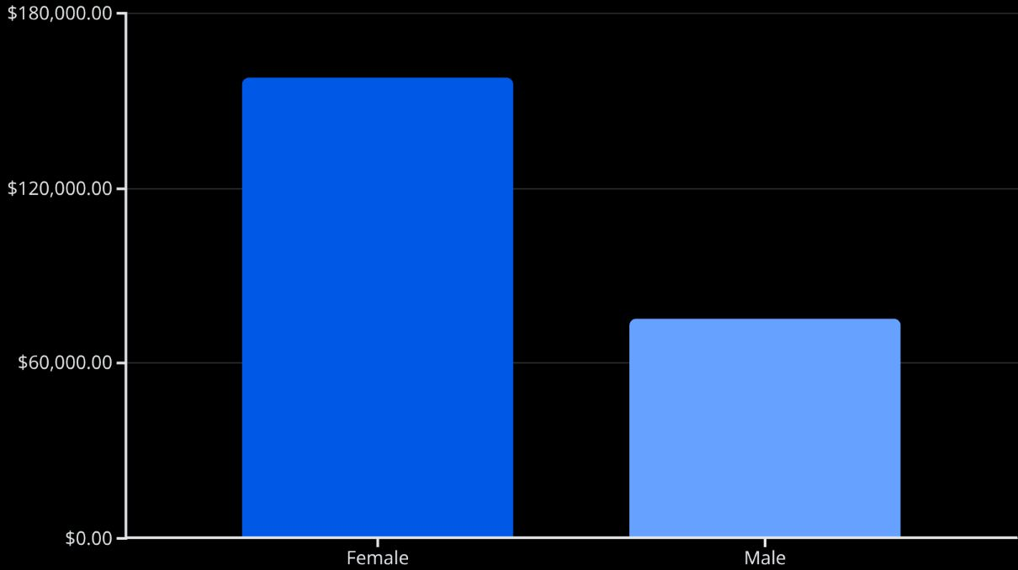
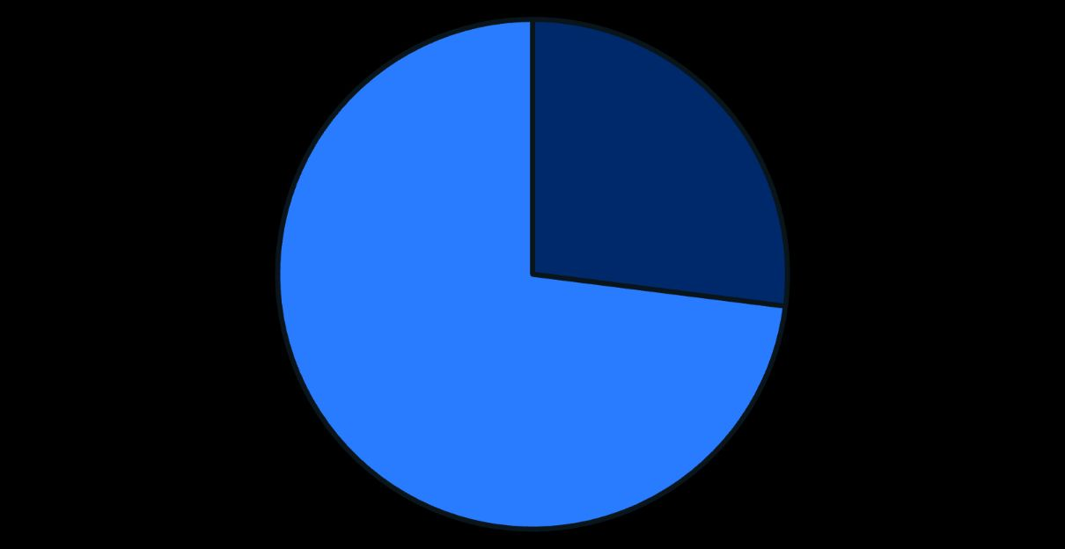
SQL Business Analysis
Yes
No
Female customers generated significantly higher revenue.
Non-subscribers represent a larger customer base.

Slide 6
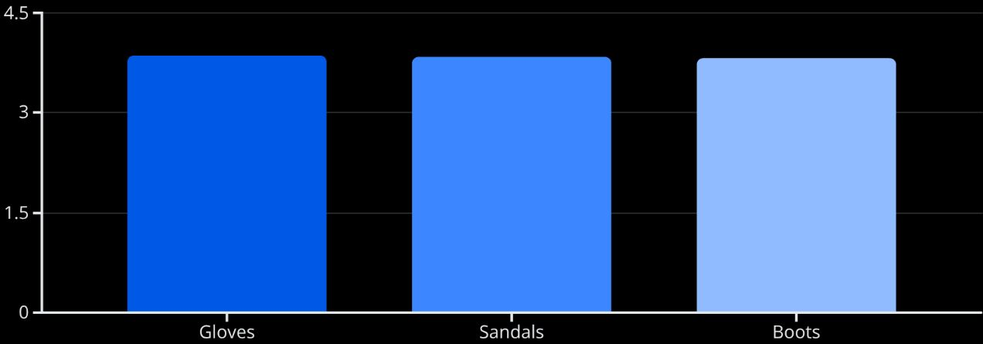
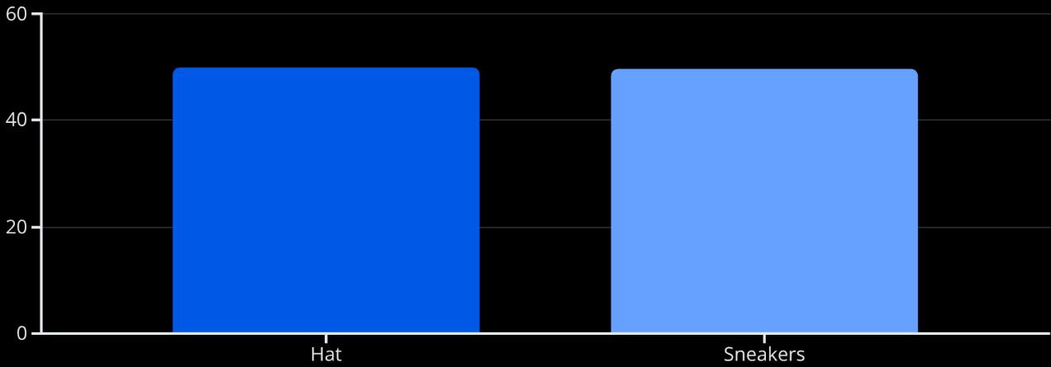
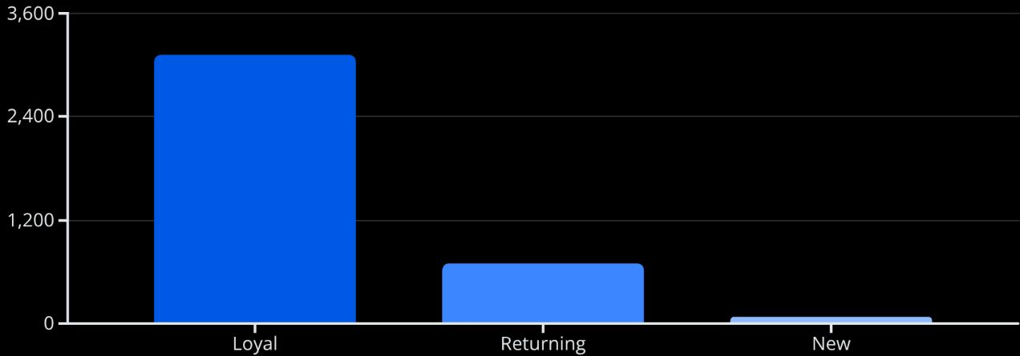
Deeper SQL Insights
Top Products by Rating
Discount-Dependent Products
Gloves show a slight lead in average customer ratings.
Hats and Sneakers are highly dependent on discounts for sales.
Customer Segmentation
High-Spending Discount Users
A segment of high-spending customers frequently use discounts. They are valuable targets for future promotions or loyalty programs.
Loyal customers form the majority, indicating strong retention.

Slide 7

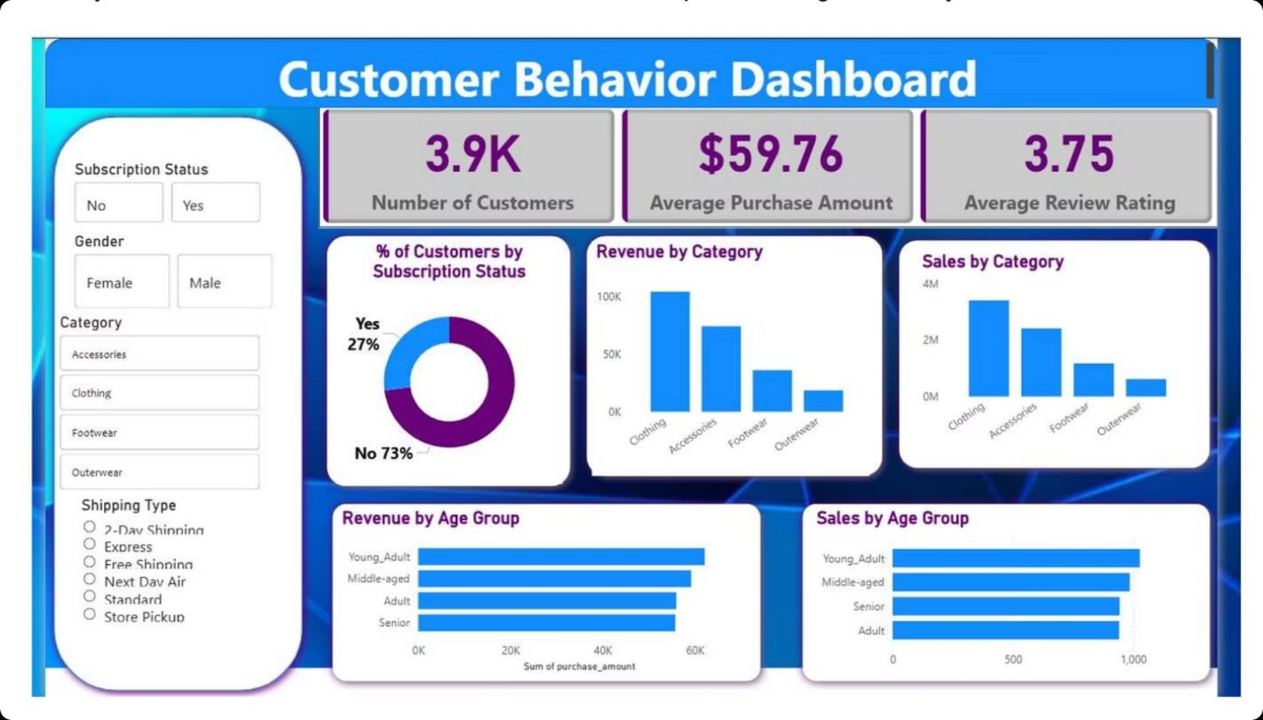
Power BI Dashboard
Interactive dashboard for visual insights.

Slide 8
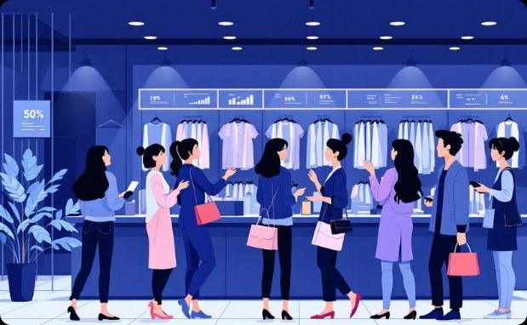




Key Insights & Findings
Revenue Contribution
Subscriber Spend
Product Performance
Shipping Impact
Females contributed higher revenue.
Subscribers spend more on average.
Top-rated products overlap with best sellers.
Express shipping users spend more.
Customer Loyalty
Loyal customers drive major sales.

Slide 9
Business Recommendations
Boost Subscriptions
Customer Loyalty
Optimize Discounts
Promote exclusive benefits.
Reward repeat buyers.
Balance sales with margin control.
Product Positioning
Targeted Marketing
Highlight top-rated products.
Focus on high-revenue age groups.

Slide 10

Conclusion
Our data-driven analysis, using our Python-SQL-Power BI workflow, offers a clear roadmap for better strategy and better customer relationships. Key findings show female customers are a key driver of revenue ($157,890 vs. $75,191 from male customers), showing a main group for growth. Our 80% loyal customer base is an important strength, always leading to big sales.
Product performance shows 'Gloves' have a strong average rating of 3.86, making them worth investing in. In contrast, 'Hat' products always need big 50% discounts to sell, suggesting we need to rethink how we sell them and their prices.
Based on these insights, our immediate next steps include:
Launch targeted marketing campaigns for high-revenue female customers.
Improve loyalty programs for our 80% loyal customer base.
Develop a revised strategy for 'Hat' products to reduce the need for steep discounts and improve profitability.

